Slide 1



AI & LLM with
2024 Summer Workshop
Dr. Timothy D.
Bowman "Dr. B"
Timothy D Bowman, PhD (Tim or Dr B) he/him/his
Associate Professor, The iSchool
tbowman@dom.edu
Phone: (708) 524-6653
Office Room: Crown 324,
7900 Division Street,
River Forest, IL 60305

Slide 2
Intro Survey
https://forms.gle/f74V6bFYrqx1dMD67

Slide 3
Workshop Info:
Place: The workshop will take place on campus in Lewis 002. This is one of the computer classrooms in the Tech Center.
Time and dates: Monday, August 12 to Friday, August 16 from 9 am to 4 pm. Let me know if you can’t be there for the entire workshop.
Lunch: Lunch will be provided on campus each day of the workshop.
Payment: Students who complete the entire workshop and participate in presenting their group project at the fall URSCI Mini-Expo (Sept. 5, 5-7pm in Parmer Hall) will be eligible for a financial aid payment of $1000.
To receive this payment, you must also have filed a FAFSA with DU and not exceed your cost of attendance. If you will exceed your cost of attendance, you may still participate in the workshop, but we cannot award the payment. If you have any questions, please reach out to finaid@dom.edu.

Slide 4




Who is Dr. B?
Chicago, Dec 2023
Dr. Timothy D Bowman is from Bedford, IN, USA.
I study altmetrics / social media / AI / LLMs
I was an IT professional for over 15 years.
I am 51 years old and I am a Gemini.
I have a wife Sarah, 2 cats Bunsen and Beaker, and our sweet dog Denali.
I have no children.
I am a self-proclaimed geek and I used to be a skate punk/punk.
Sarah and I have lived in Canada (Montreal) and in Finland (Turku), though I still can only speak English fluently.
I have visited 44 of the 50 United States.
Sarah and I have visited 20 out of 195 countries (we haven't been to Africa, Antarctica, or Australia, or South America yet)
I have been in academia as a faculty member for 9 years
I earned my undergraduate BS degree in Psychology (NeuroPsychology) from Indiana State University.
I earned my Master's Degree in Information Science and a Ph.D. in Information Science from Indiana University Bloomington
My hobbies include woodworking, 3D printing, DIY'ing, and contemplating
I am also an avid audiobook listener
Tim
Sarah
Beaker
Bunsen
Denali

Slide 5
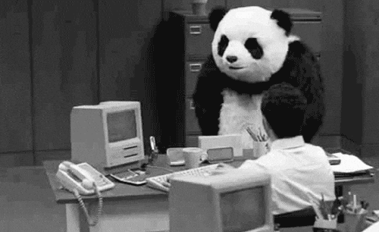
Words to remember…
Programming can be immensely rewarding! When you can tackle a complex problem by writing a program it’s very exciting and fulfilling. When your boss can’t figure something out and you write code to solve the problem, it’s great.
Programming can be frustrating! If you forget to use proper syntax, forget how to use a specific module or class, leave a huge security hole in your program, it can be very annoying and exasperating because the code won’t execute.
You won’t learn how to write complex Python programs overnight. Give yourself time to learn, forgive yourself for mistakes; it will help. Don’t be afraid to make mistakes! You won’t destroy the world. Mistakes are an important way we discover and remember, especially when learning to program.
https://giphy.com/gifs/panda-table-flip-e24Q8FKE2mxRS

Slide 6


Useful Free Software
Anaconda software package
It installs the newest version of Python (v3.x) on Windows, Mac, or Linux computers
It comes with pre-installed Python libraries for us to use
It will install Visual Studio Code, which is very useful (https://code.visualstudio.com/)
It installs Jupyter Notebook, which is a tool we can use to share our code (https://jupyter.org/)
https://anaconda.com/
https://www.anaconda.com/products/ai-navigator
https://docs.anaconda.com/ai-navigator/getting-started-ai-navigator/

Slide 7



Sign up for Free Accounts
Github - https://github.com/
HuggingFace - https://huggingface.co/
Langchain - https://www.langchain.com/langsmith
NOTE: These all offer free and paid accounts. If you are going to be serious about AI and LLM development with Python, you may need to pay for these services as the free accounts are limited.

Slide 8
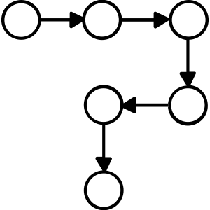
Step back and think about procedures (flow)
A procedure is simply a set of steps you follow to perform a task
Computers can’t perform tasks without procedures!
Writing procedures can be difficult:
You’ll forget a step
You’ll mistake the order
You’ll forget to transform data, etc..
An application contains all the procedures necessary to complete a task
Writing an application involves defining and writing all the steps for the computer to perform to accomplish some task
Remember: A computer performs a task precisely as you write it! A computer will not catch your mistakes and compensate.

Slide 9




Programming Languages
Human speech is imprecise! Computer are literal!
We need another language to get things done…
Programming languages make it possible to write procedures that are both precise and can be understood by both humans and computers

Slide 10
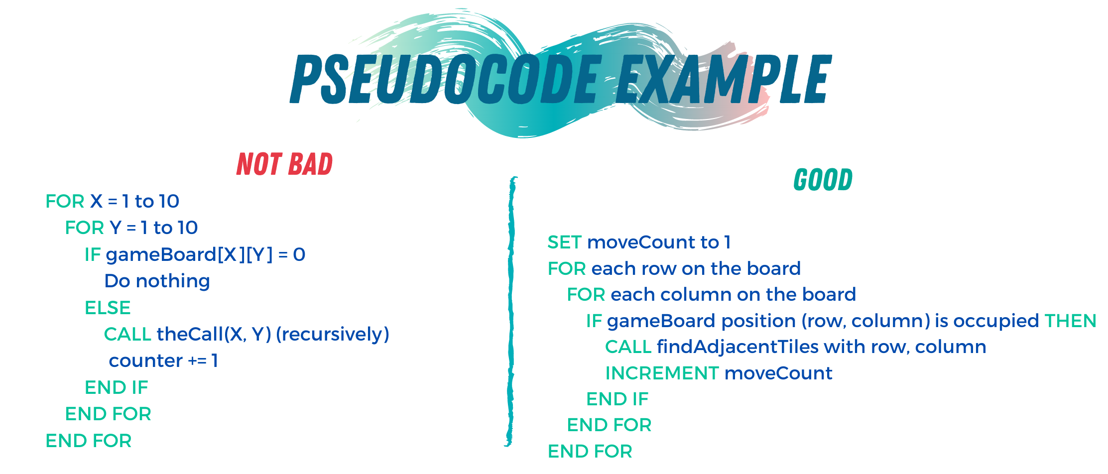
Pseudocode
Pseudocode: English-like description of an algorithm in a made-up computer language
Write up pseudocode for your program
Turn each statement into a comment in your script
This creates an outline so you can write your code!
https://towardsdatascience.com/pseudocode-101-an-introduction-to-writing-good-pseudocode-1331cb855be7

Slide 11
Rocks
Programming languages are plentiful! https://en.wikipedia.org/wiki/List_of_programming_languages_by_type
Python code is 2-10x shorter than comparable code writing in other languages
Python code is easier to read (for a human) than other languages
Python is easy to learn!
Check out: https://www.python.org/about/success/

Slide 12
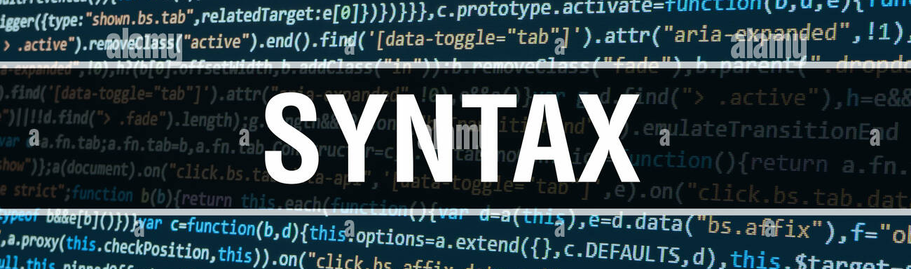
Python Syntax
Look at the PEP 8 -- Style Guide for Python Code https://www.python.org/dev/peps/pep-0008/
It’s all about CONSISTENCY!
Know when the style guide won’t work for your project but be consistent in whatever you do.
Indentation => 4 spaces This is default in many editors
Spaces are preferred over tabs
Python 3 doesn’t allow mixing of tabs and spaces for indentation
Line Length => 79 characters

Slide 13
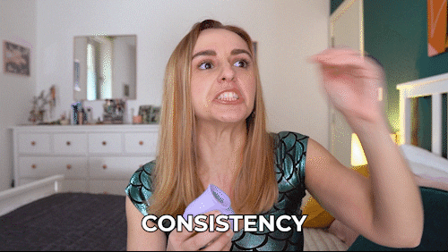
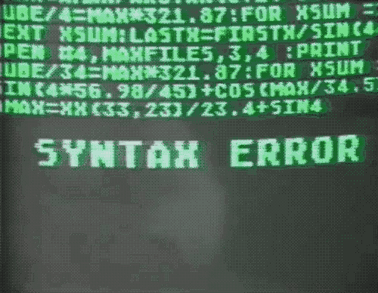
--->
BE CONSISTENT!
or
BE FRUSTRATED
https://giphy.com/gifs/HannahWitton-hannah-witton-POhImPUEBl6bR2EIW0
https://giphy.com/gifs/mememe-ememe-memememmeme-Q0OqU2N1MN3KU

Slide 14
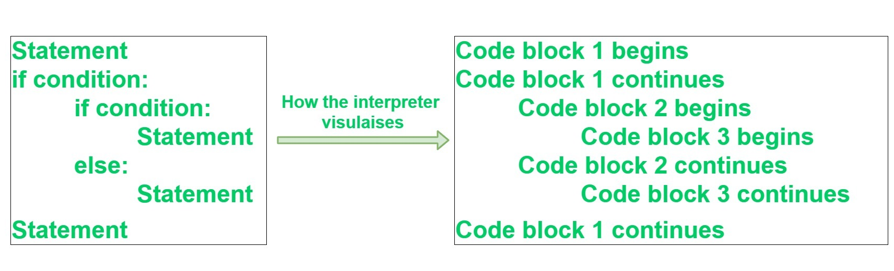
Python Block Syntax
Block Grouping:
A language that allows grouping with blocks is sometimes called a block structured language
Indentation is used to distinguish a block in Python
A block is a group of statements in a script
Some languages use { … } to distinguish blocks (like JavaScript or PHP)
In Python, code blocks are defined by their indentation
The statements within a block will line up vertically
Block 1
4 spaces
Block 2
8 spaces
Block 3
4 spaces
Block 2, continuation
Block 1, continuation
PEP 8 recommends that you always use 4 consecutive spaces to indicate indentation. This is what we will do!!!
NOTE: You can use spaces or tabs! But it MUST be consistent, or you will receive an error when you try to execute the script.

Slide 15

Storing Information
Variables
It means: something that changes
are a way of referring to a memory location used by Python (or basically any computer program)
In many programming languages, a variable is a symbolic name for a physical location
Think of it as a container
A variable stores the assigned information, which we can access through its name
42
bucket
<variable> = <expression>
bucket = 42
assignment -> not equals
print(bucket) → This outputs the value of: 42
Notes:
You will be required to add comments to all the code you write in this course.
This allows me to see that you understand what is happening and it allows you to think about what you are doing in your code.
Remember, a program can be thousands of lines of code and you can forget what is happening in chunks of code unless you add comments! Trust me, I get so mad at myself when I forget to comment code and come back to it a few weeks after I wrote it and can’t remember why I did what I did. It’s important.

Slide 16

Variables - Case Sensitivity
Variable names and keywords are case sensitive.
fooBar = "Tim"
foobar = "Tim"
These are two different variables!
This will drive you crazy in your coding if you accidentally capitalize a variable name one place in the code and don't capitalize it in another. The code won't work as you expect. REMEMBER THIS!
foobar
fooBar
Notes:
You will be required to add comments to all the code you write in this course.
This allows me to see that you understand what is happening and it allows you to think about what you are doing in your code.
Remember, a program can be thousands of lines of code and you can forget what is happening in chunks of code unless you add comments! Trust me, I get so mad at myself when I forget to comment code and come back to it a few weeks after I wrote it and can’t remember why I did what I did. It’s important.

Slide 17

Assignment Statement
An assignment statement is:: a line of code in which a variable is given a value
<variable> = <expression> (expression can be many different things!)
If the variable has never been assigned before, Python allocates an empty slot of memory, attaches the name to it, and puts in the value

Slide 18
Assignment Statement (cont)
44
44
myAge
You can assign a variable's value to another variable OR combine values to create a new value for another variable OR ….
myAge
yourAge
44
44
myAge
yourAge
myAge = 44
yourAge = myAge
print(yourAge) # output is 44
nMales = 23
nFemales = 21
nPeople = nMales + nFemales
print(nPeople) # ouptut is 44
23
21
+
44
nMales
nFemales
nPeople

Slide 19
Python - Basic Data Types
Integers --> int
Includes positive and negative integers, including zero; no decimals
1, 2, 100, 1235456
Floats --> float
Real numbers with decimal points
1.1, 3.14, 569.32
Strings --> str
Also known as text, contains any sequence of characters
"Here's a string with a single quote in it."
Booleans --> bool
Only two possible values: True or False (must be assigned capitalized)
Notes:
You will be required to add comments to all the code you write in this course.
This allows me to see that you understand what is happening and it allows you to think about what you are doing in your code.
Remember, a program can be thousands of lines of code and you can forget what is happening in chunks of code unless you add comments! Trust me, I get so mad at myself when I forget to comment code and come back to it a few weeks after I wrote it and can’t remember why I did what I did. It’s important.

Slide 20
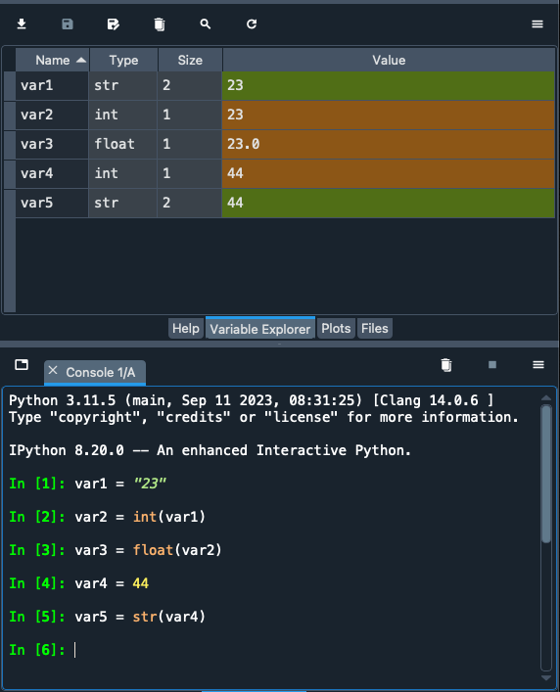
Casting Values
You can specify a type on any variable and Python will treat it as such; this is called CASTING
We can use Python's constructor functions that are built into the language to do this:
int() – constructs an integer number
float() – constructs a float number
str() – constructs a string

Slide 21
Python - Numbers & Expressions
OPERATOR | DEFINITION
+ | Addition
- | Subtraction
* | Multiplication
/ | Division (float)
% | Modulus
** | Power
// | Integer Division
Notes:
You will be required to add comments to all the code you write in this course.
This allows me to see that you understand what is happening and it allows you to think about what you are doing in your code.
Remember, a program can be thousands of lines of code and you can forget what is happening in chunks of code unless you add comments! Trust me, I get so mad at myself when I forget to comment code and come back to it a few weeks after I wrote it and can’t remember why I did what I did. It’s important.

Slide 22
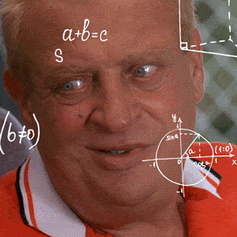
Math - Order of Operations
PEMDAS:
Parentheses
Exponents
Multiplication
Division
Addition
Subtraction
https://giphy.com/gifs/rodneydangerfield-thinking-math-rodney-gEvab1ilmJjA82FaSV
x = 5 + 4 * 9 / 6
x = 5 + 36 / 6
x = 5 + 6.0
x = 11.0
Why is it 11.0 and not just 11?

Slide 23
Keywords in Python
and | as | assert | break | class
continue | def | del | elif | else
except | exec | if | import | in
is | lambda | not | or | pass
print | raise | return | try | while
yield | True | False | None
You can't use any of these as variable names. They are reserved by Python
because they already have built-in functionality.
https://docs.python.org/3/library/keyword.html#module-keyword

Slide 24
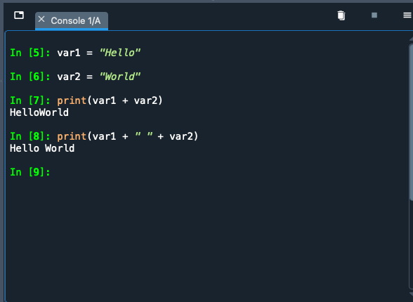
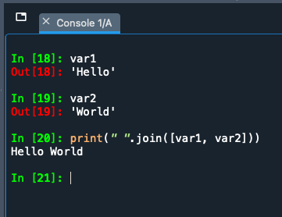
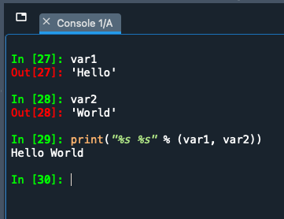
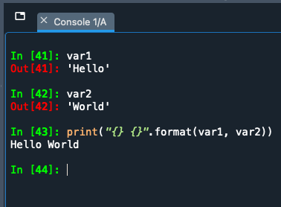
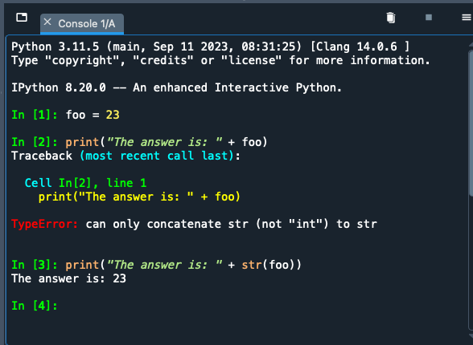
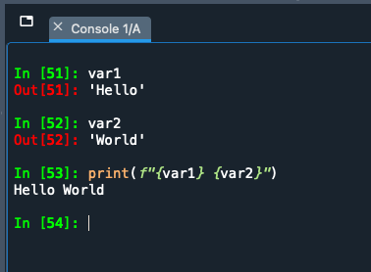
Basic Concatenation (examples)
'+' operator
join() method
'%' operator
format() function
I personally prefer this method because I can see the variables easily
must force Python to treat int as str using str() function
Python F-string (https://peps.python.org/pep-0498/)

Slide 25
LOGIC with the if … else
We can run very simple logic using 'if … else'.
We are asking Python to run code based on a (series of) test(s) https://docs.python.org/3/reference/compound_stmts.html#index-3
First, the code asks to test whether a statement is TRUE
If it is TRUE, it runs a certain chunk of code
If it is FALSE, it skips the TRUE code and runs the else chunk of code.
if condition is True
condition
execute if code chunk
if condition is False
execute else code chunk
colon
4 spaces indentation
if <condition>:
print("This condition was True")
else:
print("The condition was False")
colon
4 spaces indentation

Slide 26
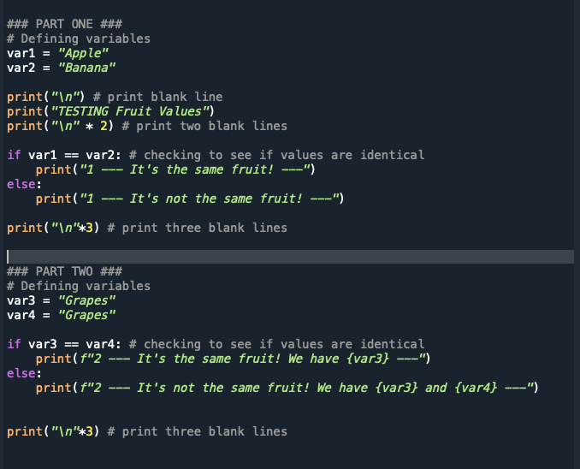
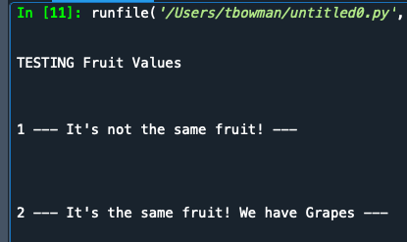
if … else → Comparison of values example using ==
REMEMBER: In Python, code blocks are defined by their indentation. The statements within a block will line up vertically
Block 1
4 spaces
Block 2
8 spaces
Block 3
4 spaces
Block 2, continuation
Block 1, continuation
CODE >> simpleIf-Else.py

Slide 27
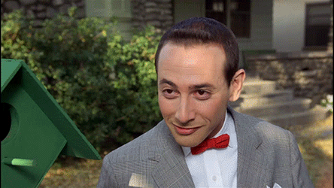
if … elif … else
if <condition>:
print("first condition is True")
elif <condition>:
print("second condition is True")
elif <condition>:
print("third condition is True")
else:
print("none of the conditions were True")
if condition
if condition #1 is True
execute if code chunk
elif condition #n
if condition #n is True
execute elif code chunk
if ALL conditions are False
else code chunk
https://giphy.com/gifs/aI7Ret2L4hnMI

Slide 28
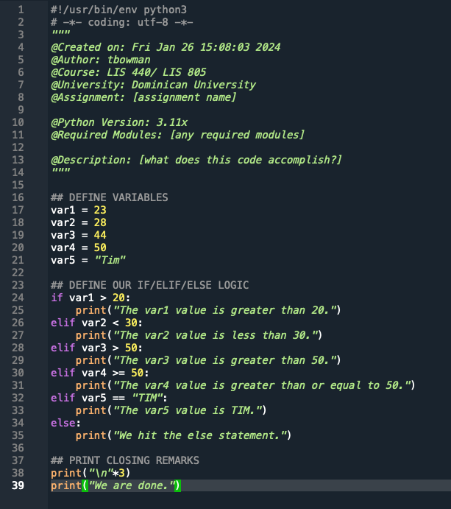
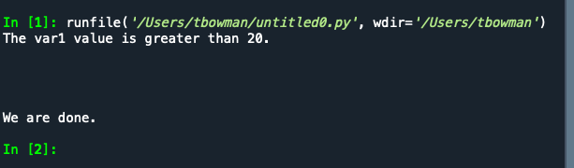
if … elif … else
NOTE: The conditions are MUTUALLY EXCLUSIVE.
Once one condition is triggered in this if..elif..else, none of the other conditions are checked.

Slide 29
List of Built-in Functions
abs() | dict() | help() | min() | setattr()
all() | dir() | hex() | next() | slice()
any() | divmod() | id() | object() | sorted()
ascii() | enumerate() | input() | oct() | staticmethod()
bin() | eval() | int() | open() | str()
bool() | exec() | isinstance() | ord() | sum()
bytearray() | filter() | issubclass() | pow() | super()
bytes() | float() | iter() | print() | tuple()
callable() | format() | len() | property() | type()
chr() | frozenset() | list() | range() | vars()
classmethod() | getattr() | locals() | repr() | zip()
compile() | globals() | map() | reversed() | __import__()
complex() | hasattr() | max() | round()
delattr() | hash() | memoryview() | set()
https://docs.python.org/3/library/functions.html

Slide 30
User-Defined Functions
User-Defined Functions give us power and save us time!
A function: series of related steps (statements) that make up a task, which can be called in multiple locations within a program.
def: stands for definition. We are defining a new function for Python to use; it stores the location of the function in memory.
When naming user-defined functions, keep the name simple and generic!
Keep functions at the top of your code! If you try to call a function before you define it, you'll receive an ERROR.
Don't forget the colon!
def <functionName>(optionalParameters):
<indentedStatements> # this makes up the body of the function
Don't forget the indentation!

Slide 31
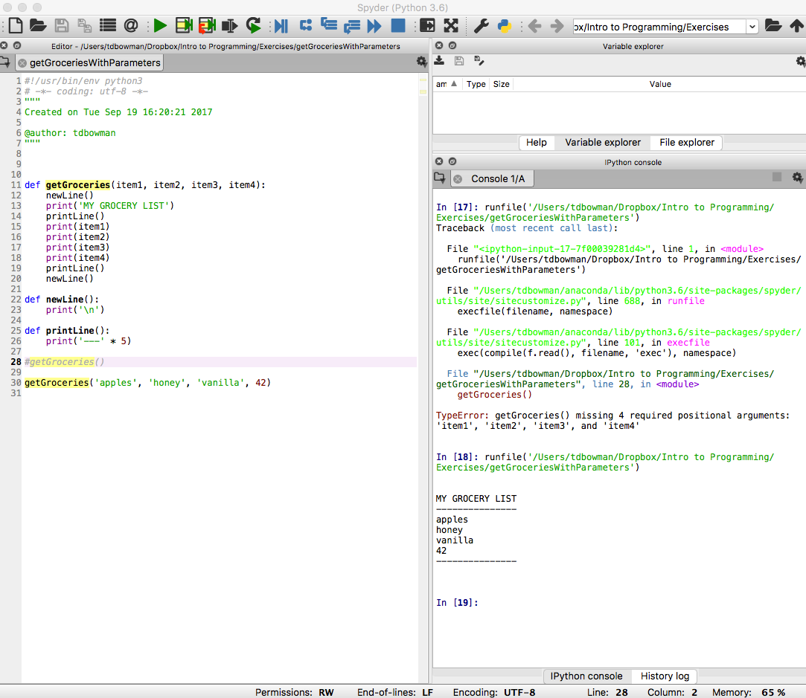
Function Parameters
Parameter: a variable that is assigned a value when the function starts. This is important! Unless you assign a default value to the parameter (which we'll talk about later), the parameter variable is empty.
NOTE: There are 4 parameters in the function 'getGroceries'.
def getGroceries(item1, item2, item3, item4):
print('I need ' + item1)
print('I need ' + item2)
print('I need ' + item3)
print('I need ' + item4)
print('\n') #blank line
If you execute with line #28 not commented you will receive ERROR!
Each parameter takes on the value and the type of whatever argument is passed in.

Slide 32
Simple Addition Function
Task:
Build a routine that (1) accepts a numeric parameter, (2) adds the parameter variable to 2, and (3) print the result.
def addTwo(startingVal):
endingVal = startingVal + 2
print('The sum of ' + str(startingVal) + ' plus 2 is: ' + str(endingVal))
print('\n') #blank line
NOTE: There is only 1 parameter in this function.
-- Also, I'm using built-in functions(i.e. the str() function) inside my user-defined function!

Slide 33
Returning one Value (instead of printing)
Task:
Build a routine that (1) accepts a numeric parameter, (2) adds the parameter variable to 2, and (3) returns the result.
return <returnValue>
def addTwo(startingVal):
endingVal = startingVal + 2
return endingVal #return here
NOTE 1: There is only 1 parameter in this function. It no longer prints the results; instead, it returns the value.
NOTE 2: Whenever you use a return statement in a function, the execution of the code exits (stops) immediately and you are returned to the main body of code where the function was called!

Slide 34

Scope
Scope: the amount of code over which a variable is active.
This is important to understand, otherwise you won't get the results you expect!
Variables can ONLY be used after they have been declared!!!
Functions can ONLY be used after they have been defined!!

Slide 35
Scope (cont)
A variable defined in the main body (top level) of a program is called a global variable. You can also specifically define a variable as global.
Global variables are available throughout a program (after they are initially defined)
You can use a global variable inside a function without causing a Python error, but it is strongly NOT recommended; it can be confusing. Instead of using a global var inside a function, pass it as a parameter into the function.
A variable defined inside a function is referred to as a local variable
Local variables only exist inside the function once it is run and cease to exist after the function has ended running
A variable defined as nonlocal is useful when nesting functions (see link below)
The usage of nonlocal is very similar to that of global, except that the former is used for variables in outer function scopes and the latter is used for variable in the global scope.
https://www.smallsurething.com/a-quick-guide-to-nonlocal-in-python-3/

Slide 36
Loops
Loop: A block of code that is repeated until a certain condition is met.
Most modern apps would not function without loops!!!
https://realpython.com/python-for-loop/
https://realpython.com/python-while-loop/

Slide 37
While Loop
The syntax for a while loop is similar to the if statement
The body of the loop is the code that is indented within the while statement
As long as the Boolean expression is True, the statements in the body of the loop are repeated
When the Boolean expression is False, the body of the loop is skipped and execution continues with first line after while statement
# runs as long as the expression
# evaluates to True
while <Boolean expression>:
<indented block of code>
NOTE: If the condition never equals False, the loop will run infinitely! This is called an "infinite loop"

Slide 38
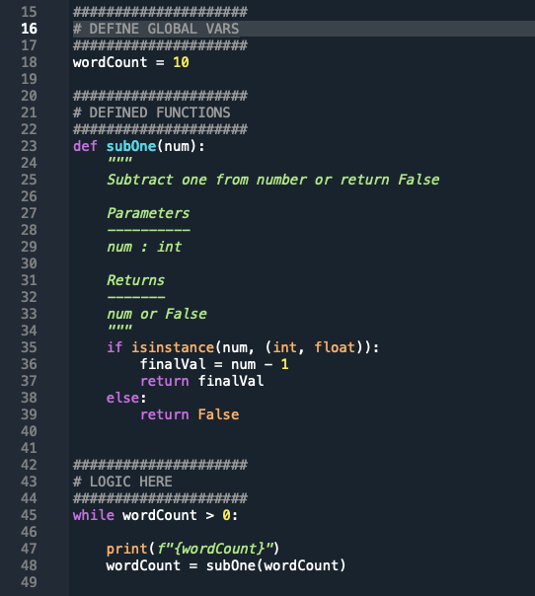
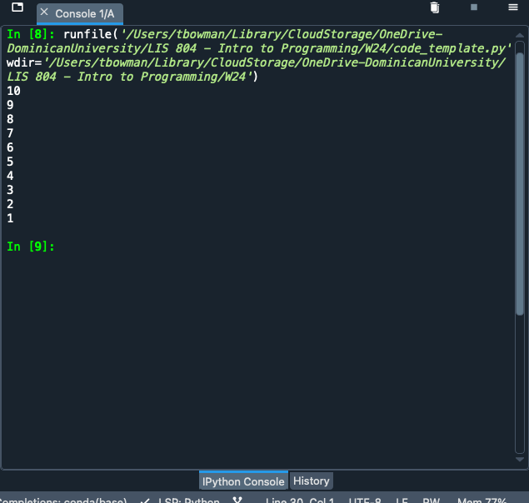
Loops and User-Defined Function
Running this subOne(num) function inside while loop

Slide 39
for Loop
for loop: The code executes a set number of times
The for loop works through a sequence of some type
The <variable> in the for loop is assigned a single element in the sequence each iteration
for <variable> in <sequence>: <statements>
else:
<statements>

Slide 40
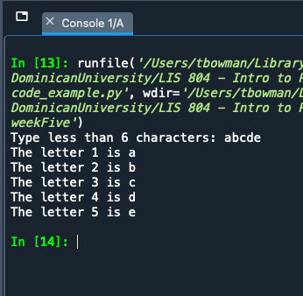
for Loop
pretend user typed "abcde"
letterNum = 1
value = input("Type less than 6 characters: ")
for letter in value:
print(f"The letter {letterNum} is {letter}")
letterNum += 1 # add one to counter
if letterNum > 6: # perform check on value
print("The string is too long!")
break
for <variable> in <sequence>
test iteration
'break' allows us to exit loop

Slide 41
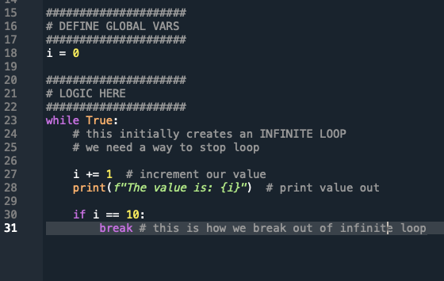
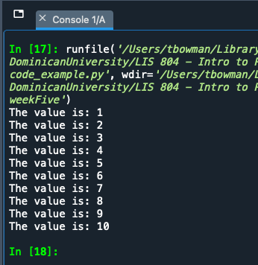
break
break - control is immediately transferred to the first statement past the last line of the loop
The technique of writing an infinite while loop using a while True statement and using break is effective and clear.

Slide 42
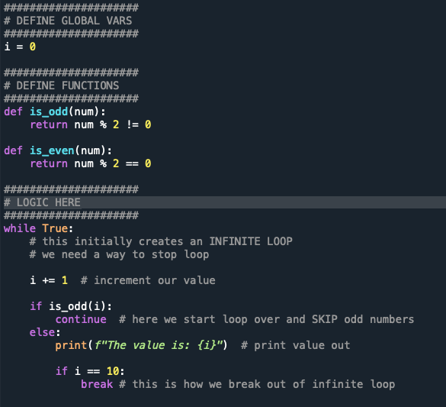
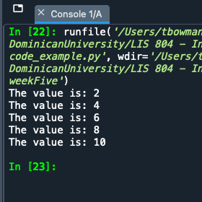
continue
continue- the execution of the code is immediately passed back to the beginning of the loop
Whatever code is after the continue gets skipped.

Slide 43
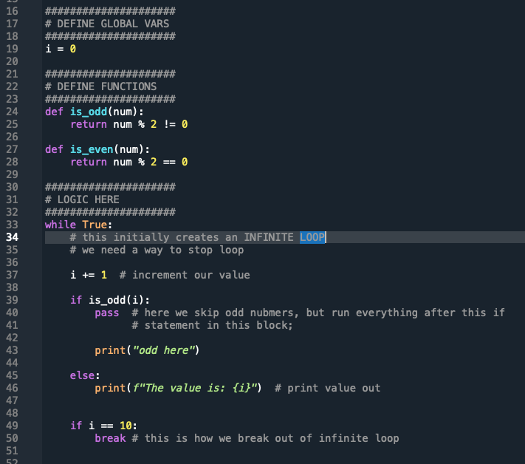
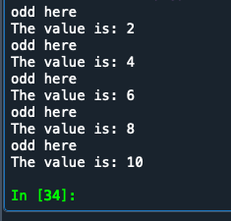
pass
pass - works almost the same way as continue, except that it allows completion of the code in the if code block in which it appears
it allows for post-processing on the element

Slide 44
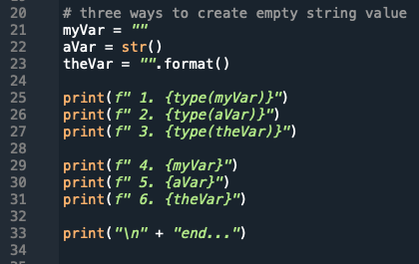
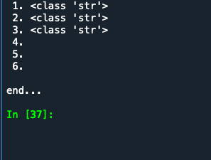
empty string
empty string - value of no characters; represented by two quotes; considered a string data type
can be either '' or ""
this is different from None value
can be of value to hold spot in lists or dictionaries

Slide 45
Data Structure
A data structure is a collection of multiple pieces of data, arranged in a way that the data can be accessed efficiently.
Tuple
Immutable Array
Lists
Mutable Array
Dictionaries
Hashtables

Slide 46
Lists --- []
Lists are a kind of sequence.
Sequence is a means of allowing multiple data to exist together in a single unit, but as separate entities.
Lists are mutable!
This has a beginning, middle, and end (just like on a piece of paper)

Slide 47
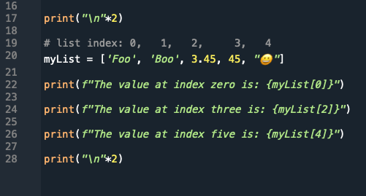
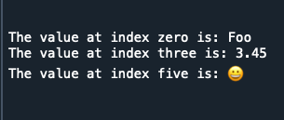
Creating Lists – []
NOTE: It's best practice to create lists of the same type, though Python allows us to created mix-typed lists, too (as mentioned on the previous slide)
Creating a list is somewhat like creating a variable with a single value:
index
0, 1, 2, 3, 4
myList = ["One", 4, "Tim", 3.45, False]

Slide 48
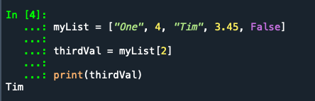
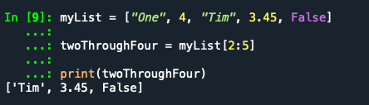
Accessing data from our lists
Remember: It's a zero-based index!
To get the third item in our list, what do we use???
We can also get a range of values back from our list using a colon. NOTE: The second parameter is the number after the one we want See below!
[ 0, 1, 2, 3, 4 ] ← list indexes
myList = ["One", 4, "Tim", 3.45, False]
thirdVal = myList[2]
We ask for index 2, NOT 3!
Why did I use 5 here???

Slide 49
List of lists
The data inside a list can be any data type.
This can be: int(), float(), str(), Boolean, or even a list
NOTE: in other programming languages a list of lists is called a multidimensional numerical array
>>> myList = [5, 3.4, [1,2,3], 33, 109]
>>> print(myList)
[5, 3.4, [1,2,3], 33, 109]
>>> print(myList[2])
[1,2,3]
<outerList>[<outerListIndex>][<innerListIndex>]
>>> print(myList[2][1])
remember
We add 2nd index to access our nested list value

Slide 50
Tuple ---> ()
Tuples are a kind of sequence.
Tuples (generally) are sequences of different kinds of stuff, and you deal with the tuple as a coherent unit.
A tuple is generally enclosed in parentheses.
Tuples are immutable!
There is considerable overlap in the ways tuples and lists can be used, but the built-in capabilities of the two structures highlight some of the distinctions (from: http://news.e-scribe.com/397).
A tuple has a numeric index (like a list)!

Slide 51
Creating Tuples
Creating a tuple is similar to creating a list:
index
0, 1, 2, 3,
tuple name
open/close parentheses
myTup = ("Tim", "Bowman", "Asst", 2016)
assignment

Slide 52
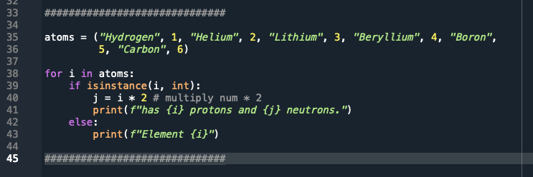
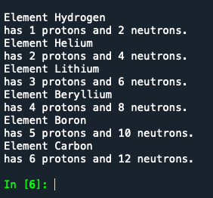
isinstance()

Slide 53
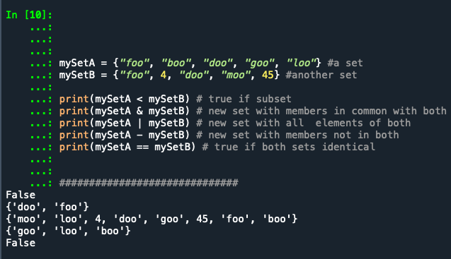
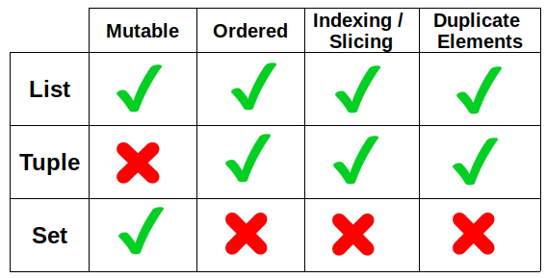
set ---> {}
Sets are an unordered collection of objects (NOT a sequence)
An element can only be a member of a given set once
Think of sets like a mathematical set, which we can compare
When you create a set in Spyder, notice that it doesn't show up in variable explorer!
Subset set1 < set2 means set1 is a true subset of s2.
Intersection set1 & set2 creates a new set containing members in common with both.
Union set1 | set2 creates a new set with all elements of both.
Difference set1 - set2 creates a new set with members that are not in both.
Equality set1 == set2 is true if both sets contain only the same elements.

Slide 54
Dictionary {}
Dictionary: similar to a list, but data is represented in what are called key/value pairs… not using a numerical index like a list[] or tuple()
The key/value is separated by a colon :
Python represents dictionaries with {} curly braces; when you see curly braces in code, you know it's a dictionary in Python
{<key>:<value>, <key>:<value>, ..., <key>:<value>}
demographDict = {'gender':'female', 'age':40, 'education':'college', 'ethnicity':'Asian', 'marital':'single'}
NOTE: in other programming languages a dictionary is called an associative array
key
value
pair

Slide 55

Dictionary {} - Described
gender = 'female'
age = 40
education = 'college'
ethnicity = 'Asian'
marital = 'single'
5 Variables
become
1 Dictionary
demographDict
demographDict = {
'gender':'female',
'age':40,
'education':'college',
'ethnicity':'Asian',
'marital':'single'
}
CURLY BRACES {}
note we can have an integer as value (no quotes)

Slide 56
Dictionary - Retrieving Data
demographDict = {
'gender':'female',
'age':40,
'education':'college',
'ethnicity':'Asian',
'marital':'single'
}
>>> print(demographDict['age'])
40
>>> print(demographDict['marital']
single
NOTE: With a dictionary, we do NOT have a numeric index! We have key/value pairs.
we use the key to retrieve the value

Slide 57
Dictionary - Updating/Adding Data
demographDict = {
'gender':'female',
'age':40,
'education':'college',
'ethnicity':'Asian',
'marital':'single'
}
# ADDING data to dictionary
>>> demographDict['veteran'] = False
# UPDATING data in dictionary
>>> demographDict['marital'] = 'married'

Slide 58
Dictionary - Iterating through
>>> demographDict = {
'gender':'female',
'age':40,
'education':'college',
'ethnicity':'Asian',
'marital':'single'
}
>>> for characteristic in demographDict:
value = demographDict[characteristic]
print('\t',characteristic,' : ',value)
gender : female
age : 40
education : college
ethnicity : Asian
marital : single
>>> for (key,val) in demographDict.items():
print('\t', key, " : ", val)
gender : female
age : 40
education : college
ethnicity : Asian
marital : single

Slide 59
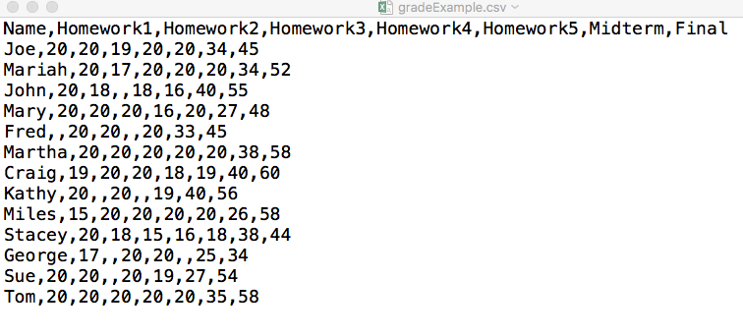
CSV Files (Comma Separated Value)
Parse: take information and separate it into more easily processed components
When looking at a CSV file in a text editor, note that the first line contains the titles of the columns.
CSV Files - csv package
https://docs.python.org/3.6/library/csv.html

Slide 60
JSON: JavaScript Object Notation
{ "base":"USD", "date":"2016-05-13", "rates":{ "AUD":1.3728, "BGN":1.7235, "BRL":3.486, "CAD":1.2882, "CHF":0.97145, "CNY":6.5211, "CZK":23.811, "DKK":6.556, "GBP":0.69403, "HKD":7.7632, "HRK":6.6109, "HUF":277.73, "IDR":13318.0, "ILS":3.7737, "INR":66.78, "JPY":108.88, "KRW":1172.8, "MXN":18.05, "MYR":4.0299, "NOK":8.1669, "NZD":1.4709, "PHP":46.645, "PLN":3.8711, "RON":3.9633, "RUB":65.271, "SEK":8.2204, "SGD":1.3705, "THB":35.43, "TRY":2.9643, "ZAR":15.168, "EUR":0.88121 } }
https://docs.python.org/3.6/library/json.html
{"base":"USD","date":"2016-05-13","rates":{"AUD":1.3728,"BGN":1.7235,"BRL":3.486,"CAD":1.2882,"CHF":0.97145,"CNY":6.5211,"CZK":23.811,"DKK":6.556,"GBP":0.69403,"HKD":7.7632,"HRK":6.6109,"HUF":277.73,"IDR":13318.0,"ILS":3.7737,"INR":66.78,"JPY":108.88,"KRW":1172.8,"MXN":18.05,"MYR":4.0299,"NOK":8.1669,"NZD":1.4709,"PHP":46.645,"PLN":3.8711,"RON":3.9633,"RUB":65.271,"SEK":8.2204,"SGD":1.3705,"THB":35.43,"TRY":2.9643,"ZAR":15.168,"EUR":0.88121}}
HINT: PRETTY IT UP > https://jsonformatter.curiousconcept.com/,
https://codebeautify.org/jsonviewer,
https://jsonformatter.org/
Notes:
Chapter 11 - Data Structures
Learn to Program with Python
Reading a Comma-Separated Value (.csv) File

Slide 61
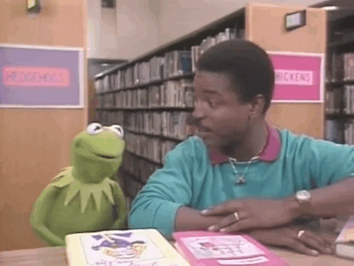
Modules
Because programs can contain thousands/millions of lines of code, a way of organization is needed. In Python, commonly used code organized into small chunks are called modules.
Generic types of commonly used code are called libraries. These terms, modules and libraries, are sometimes used interchangeably
https://giphy.com/gifs/readingrainbow-kermit-the-frog-levar-burton-xT1XGw3b5osvin2IXC
https://docs.python.org/3/tutorial/modules.html

Slide 62
Importing
In order to use a module or library, you need to import the file.
This is always done at the top of the script (after the docstring) so that module is loaded into memory and ready for use immediately.
You can import the entire module or parts of it.
import <someModule>
from <someModule> import <attributeName>
https://www.digitalocean.com/community/tutorials/how-to-import-modules-in-python-3

Slide 63
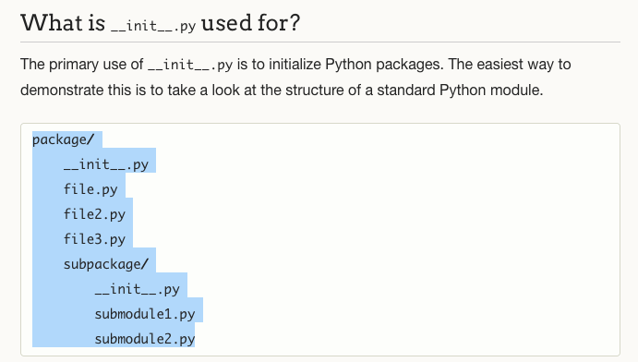
Package
A package is a hierarchical directory structure containing (potentially) many *.py files.
A top-level directory plus subdirectories
*.py files within the hierarchy
A file called __init__.py in each directory in the package
The __init__.py file tells Python the directory is part of a package and can contain configuration information and methods.
http://mikegrouchy.com/blog/2012/05/be-pythonic-__init__py.html
https://www.python-course.eu/python3_packages.php https://www.learnpython.org/en/Modules_and_Packages

Slide 64



Pandas, NumPy, Seaborn
There's also:
MatplotLib
Scikit-learn
SciPy
TensorFlow
Keras
PyTorch
NLTK
… more
https://numpy.org/doc/stable/user/absolute_beginners.html
https://pandas.pydata.org/docs/user_guide/10min.html
https://seaborn.pydata.org/tutorial.html

Slide 65
NumPy Library for Python
Universal standard for working with numerical data in Python
https://numpy.org/doc/stable/user/absolute_beginners.html
Supports Multidimensional Arrays and Matrix Data Structures
ndarray - n-dimensional array object with built-in methods you can use on the data
array → grid of values containing information about the raw data, how to locate an element in the array, and how to interpret an element.
supports large variety of mathematical operations on arrays

Slide 66
Pandas – Preprocessing
Why preprocess?
Missing Values
Inconsistencies
Noise
Exploration
ttps://pandas.pydata.org/docs/

Slide 67
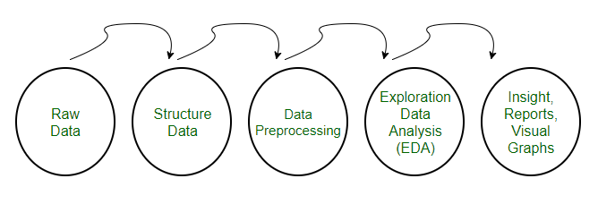
Pandas – Data Preprocessing Steps
https://www.geeksforgeeks.org/data-preprocessing-machine-learning-python/

Slide 68
Pandas – Preprocessing Steps
Cleaning: Removing or imputing missing values.
Transformation: Normalizing or standardizing data.
Encoding: Converting categorical data into numerical format.
Feature Selection: Choosing relevant features for modeling.
https://www.kaggle.com/learn/pandas
Great site for datasets!!!

Slide 69

Pandas Library for Python
Pandas is a library built on top of the NumPy Library to analyze data and manipulate data
Two Primary Data Structures:
Series – one-dimensional labeled array (dictionary or NumPy array)
DataFrame – two-dimensional data structure (rows & columns like Excel)
https://giphy.com/gifs/panda-angry-breaking-EPcvhM28ER9XW
YouTube > Basic Guide to Pandas! [20min] https://www.youtube.com/watch?v=zN2Hua6oII0

Slide 70
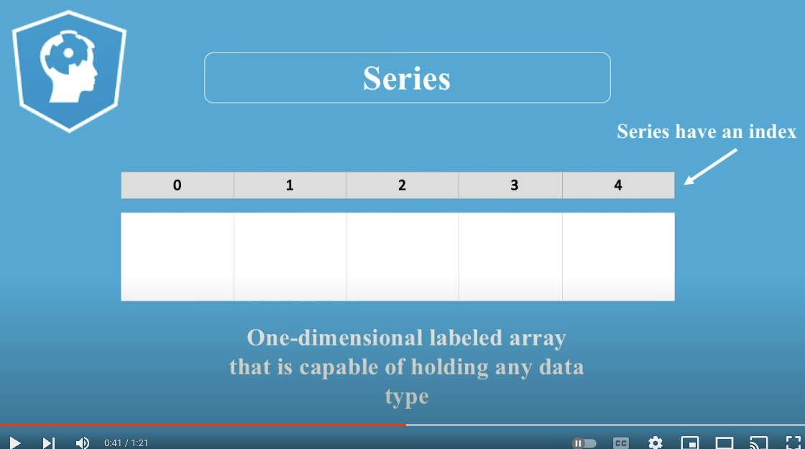
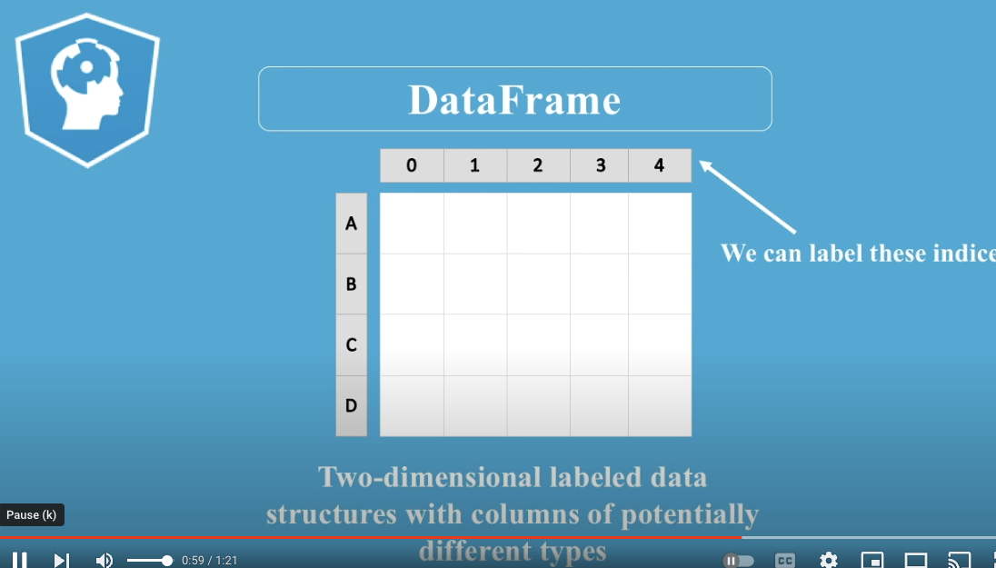
Pandas DataFrames
A DataFrame can contain:
DataFrame. (think Excel Spreadsheet)
Series. (think list)
ndarray – n-dimensional array (NumPy)
You an also specify the index and column names for a DataFrame
Index – indicates the difference in rows
Column Names – indicates difference in columns
https://www.youtube.com/watch?v=CLoNO-XxNXU&t=1s [90 seconds]

Slide 71
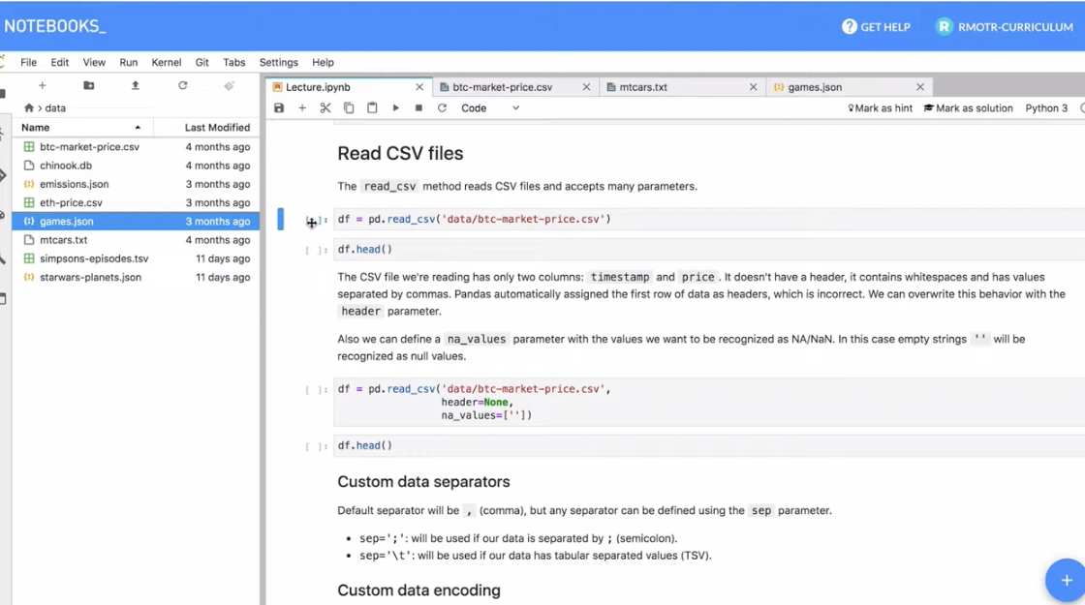
Pandas - Import Data from File
pandas.read_csv() – import any delimited file (comma, tab, semi-colon, etc) into dataframe
pandas.read_json() – import JSON file into dataframe
pandas.read_sql() – import from relational database system (MySQL, SQLite3, PostgreSQL, etc)
pandas.read_excel() – import from Excel doc
https://www.youtube.com/watch?v=fag1oWtskwU [13 min]
https://realpython.com/pandas-read-write-files/

Slide 72
Pandas - Tutorial
pandas.read_csv() – import any delimited file (comma, tab, semi-colon, etc) into dataframe
pandas.read_json() – import JSON file into dataframe
pandas.read_sql() – import from relational database system (MySQL, SQLite3, PostgreSQL, etc)
pandas.read_excel() – import from Excel doc
https://www.youtube.com/watch?v=fag1oWtskwU [13 min]
https://realpython.com/pandas-read-write-files/

Slide 73
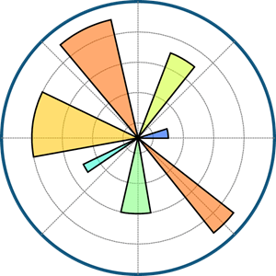
seaborn Library for Python
MatPlotLib
https://matplotlib.org/
Library for making statistical graphics in Python
built on top of MatPlotLib
operates on Pandas dataframes and Numpy arrays
supports a variety of graphics and plots
very customizable
https://seaborn.pydata.org/tutorial.html
https://realpython.com/python-seaborn/
see: https://seaborn.pydata.org/examples/index.html

Slide 74
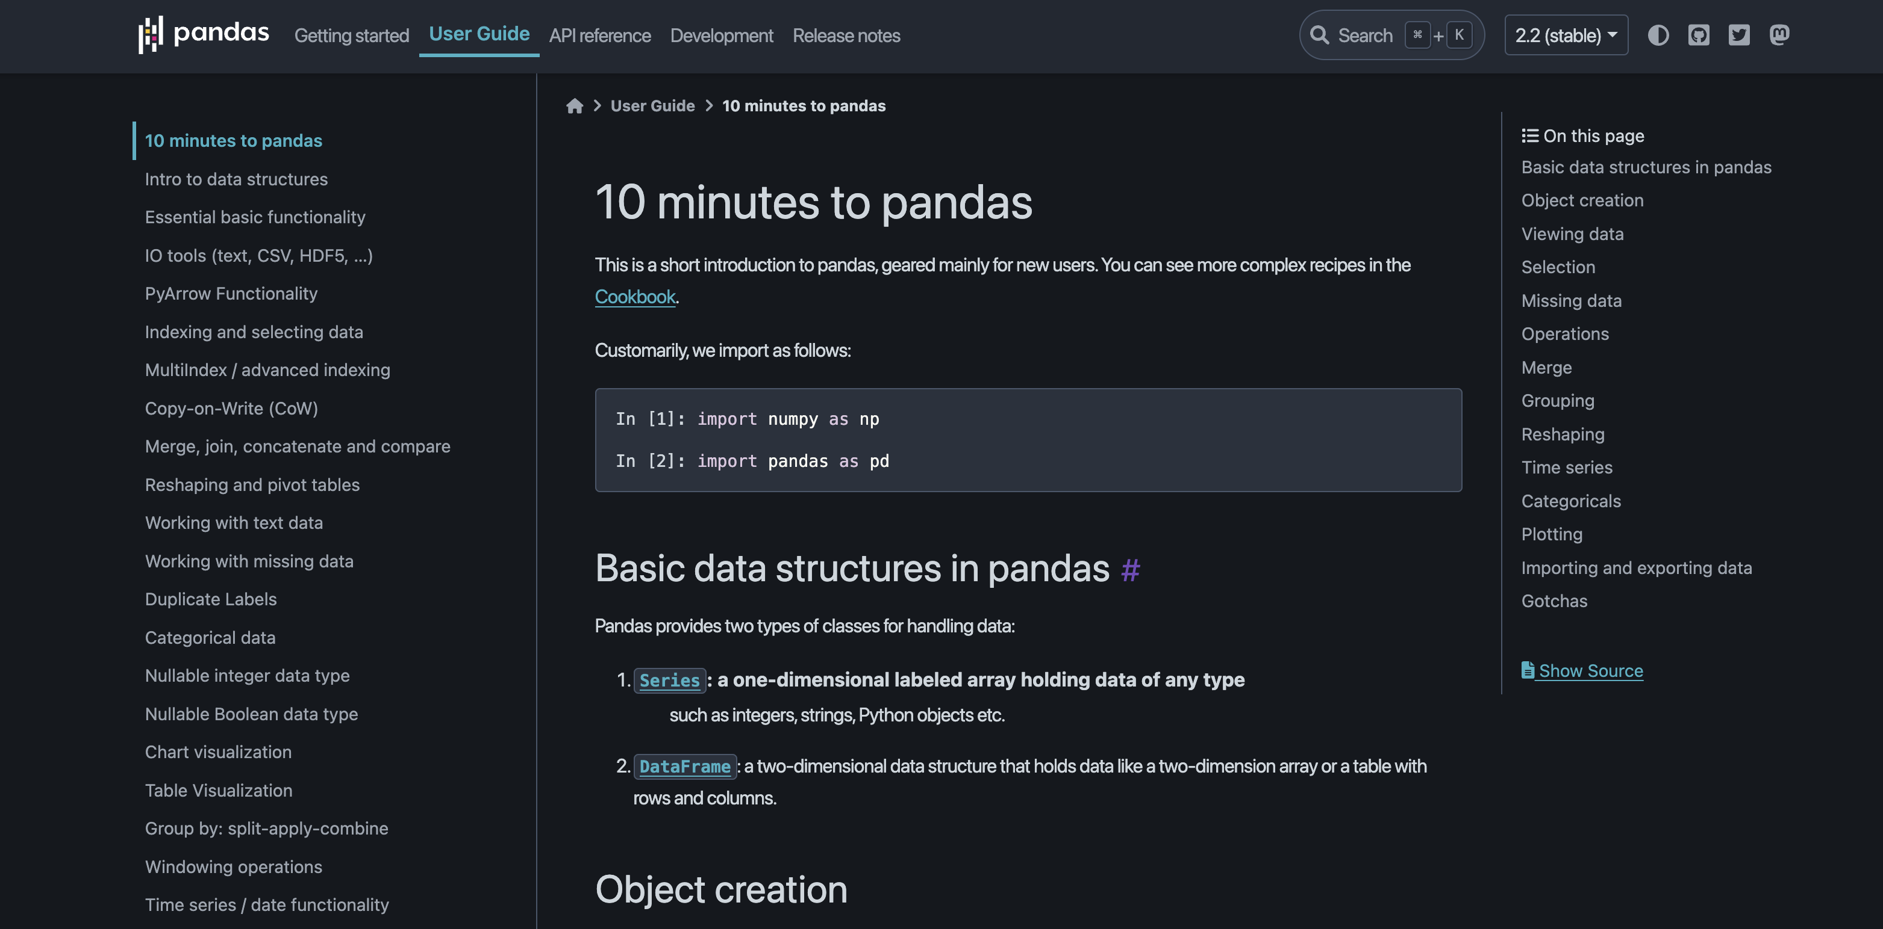
Pandas: 10 min to pandas
https://pandas.pydata.org/docs/user_guide/10min.html

Slide 75
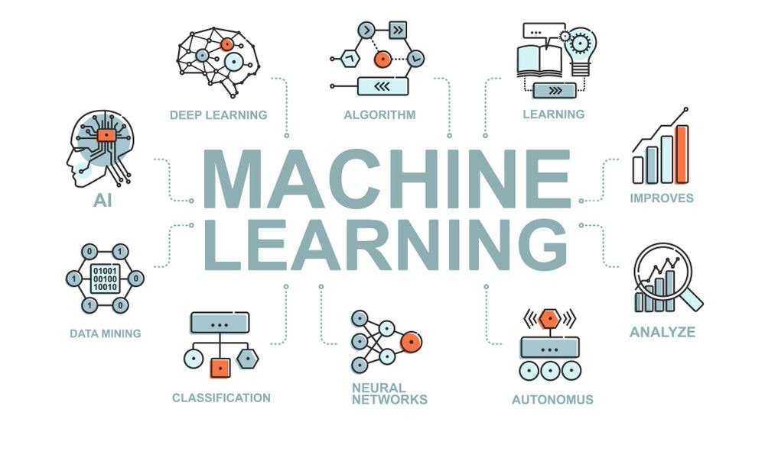
Machine Learning
What is machine learning?
a type of artificial intelligence (AI)
that enables computers to learn
from data and make decisions or
predictions without being explicitly
programmed to perform specific tasks. In simple terms, it’s like teaching a computer to recognize patterns in data and use those patterns to make decisions.
Microsoft – Machine Learning for Beginners: https://www.youtube.com/playlist?list=PLlrxD0HtieHjNnGcZ1TWzPjKYWgfXSiWG

Slide 76
Machine Learning
How Does Machine Learning Work?
Data Collection: Machine learning begins with data. This could be anything from numbers in a spreadsheet, images, text, or even sounds. The data is usually related to a specific problem you want to solve, such as predicting weather, recognizing faces in photos, or recommending movies.
Training: The computer is given a lot of data and a model (like a mathematical formula) that it will use to make decisions. The process of training involves feeding the model data and allowing it to adjust itself to better understand the patterns in that data. This is similar to how humans learn from experience.
Learning: During training, the model learns from the data by identifying patterns and relationships within it. For example, if you’re training a model to recognize cats in photos, it will learn what features (like shape, size, and color) are common in images of cats.
Prediction: After the model is trained, it can make predictions or decisions based on new, unseen data. For instance, if you show it a new photo, it can predict whether or not a cat is in the image based on what it has learned. The accuracy of the model is tested by comparing its predictions against known outcomes. If the model is accurate, it means it has learned well; if not, it might need more data or different adjustments.

Slide 77

Machine Learning
Types of Machine Learning
Supervised Learning: The model is trained on labeled data, which means each example in the dataset includes both the input and the correct output. The model learns to map inputs to the correct outputs. For example, predicting house prices based on features like size and location is a supervised learning task.
Unsupervised Learning: The model is given data without labels and tries to find patterns or groupings on its own. For example, clustering customers into different segments based on their buying behavior is an unsupervised learning task.
Reinforcement Learning: The model learns by making decisions and receiving feedback in the form of rewards or punishments. This is often used in scenarios where the model needs to learn a sequence of actions, like playing a game or controlling a robot.
https://towardsdatascience.com/machine-learning-types-2-c1291d4f04b1

Slide 78

Machine Learning
Supervised Learning: Training data with labels.
Unsupervised Learning: Working with unlabeled data.
Real-World Applications: Examples in healthcare, finance, marketing.
https://scikit-learn.org/

Slide 79

Machine Learning
Why is Machine Learning Important?
Machine learning is important because it allows computers to handle complex tasks that would be difficult or impossible to program manually. It powers many technologies we use every day, such as:
Search Engines: Improving the relevance of search results.
Recommendation Systems: Suggesting products, movies, or music based on your preferences.
Speech Recognition: Converting spoken language into text.
Self-Driving Cars: Helping vehicles navigate roads safely.
https://medium.com/@ananthvishnu/mechine-learning-a8ae7c80a91a

Slide 80

Tutorial: Machine Learning
Google Colab Document w/ Code:
https://colab.research.google.com/drive/16HdFVhvRq-DEmNU61Qp8YXMTA3CxUmg-?usp=sharing
https://www.youtube.com/watch?v=bmmQA8A-yUA&t=8137s (starting at 2:15:37) Case Study

Slide 81

Tutorial: Machine Learning
GitHub Jupyter Notebook w/ Code:
https://github.com/microsoft/ML-For-Beginners/tree/main/2-Regression/1-Tools
https://www.youtube.com/watch?v=2xkXL5EUpS0&list=PLlrxD0HtieHjNnGcZ1TWzPjKYWgfXSiWG&index=7 Your First Linear Regression Project in Python

Slide 82
Machine Learning – Good Resources
What is Exploratory Data Analysis? https://towardsdatascience.com/exploratory-data-analysis-8fc1cb20fd15
Dive in to Deep Learning (eBook): https://d2l.ai/
StatQuest with Josh Starmer (YouTube Playlist): https://www.youtube.com/playlist?list=PLblh5JKOoLUICTaGLRoHQDuF_7q2GfuJF
Kylie Ying – Machine Learning for Everyone (YouTube): https://www.youtube.com/watch?v=i_LwzRVP7bg
Machine Learning in Production (blog article) by Christian Kästner: https://ckaestne.medium.com/machine-learning-in-production-book-overview-63be62393581
PyTorch for Deep Learning and Machine Learning by Daniel Bourke (YouTube): https://www.youtube.com/watch?v=V_xro1bcAuA&list=WL&index=22&t=52s
RealPython Website - https://realpython.com/ (great tutorials in blog style with good explanations)

Slide 83

Machine Learning vs Deep Learning
Machine Learning (ML): Machine learning is a broad field of AI that involves teaching computers to learn from data and make predictions or decisions without being explicitly programmed for each task. In ML, algorithms are used to analyze and learn from data, and then make informed predictions or decisions based on that
Deep Learning (DL): Deep learning is a specialized subset of machine learning that focuses on using artificial neural networks with many layers (hence “deep”) to model complex patterns in data. These deep neural networks can automatically learn to extract features from raw data, which makes them particularly powerful for tasks involving unstructured data such as images, audio, and text.
https://www.scs.org.sg/articles/machine-learning-vs-deep-learning

Slide 84

Machine Learning vs Deep Learning
Machine Learning:
Algorithms Used: Linear regression, logistic regression, decision trees, random forests, support vector machines (SVM), k-nearest neighbors (KNN), clustering algorithms (like k-means), etc.
Feature Engineering: In traditional machine learning, a significant amount of time is spent on feature engineering, which involves manually selecting and transforming data features that will be used to train the model.
Deep Learning:
Algorithms Used: Deep neural networks, convolutional neural networks (CNNs), recurrent neural networks (RNNs), generative adversarial networks (GANs), etc.
Feature Extraction: Deep learning models automatically learn features from data during the training process, reducing the need for manual feature engineering.
https://aoyilmaz.medium.com/understanding-the-differences-between-deep-learning-and-machine-learning-eb41d64f1732

Slide 85

Machine Learning vs Deep Learning
Machine Learning:
Common Applications: Spam filtering, predictive maintenance, customer churn prediction, recommendation systems, fraud detection, etc.
Use Cases: Often used in scenarios where data is structured and the relationships between features are relatively simple and interpretable.
Deep Learning:
Common Applications: Image and speech recognition, natural language processing, autonomous vehicles, medical imaging, personalized recommendations, etc.
Use Cases: Particularly powerful in situations where the data is unstructured (e.g., images, videos, text) and complex patterns need to be detected.
https://www.datacamp.com/tutorial/machine-deep-learning

Slide 86


Machine Learning vs Deep Learning
https://pytorch.org/
https://www.youtube.com/watch?v=V_xro1bcAuA&list=WL&index=22&t=52s

